Slide 1
Olist E-Commerce Business Performance Analysis
Business Objective
Identify key revenue drivers, sales trends, seller performance patterns,
and delivery-related customer experience risks.
Data Analyst Assessment
Brazilian E-Commerce Public Dataset by Olist

Slide 2
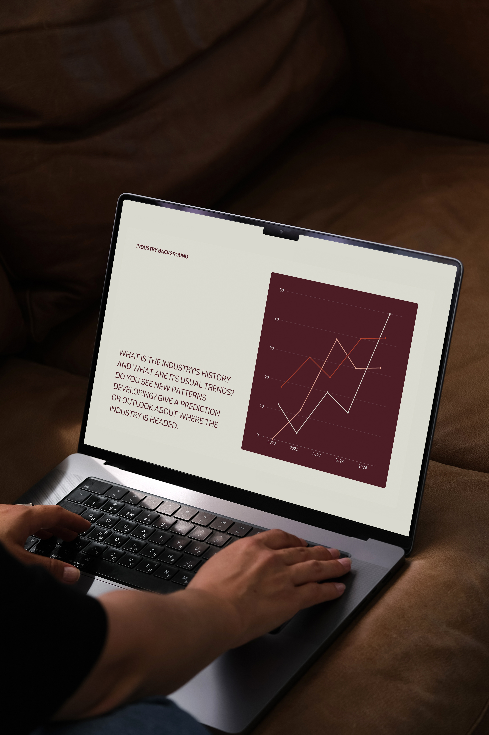
Data & Methodology
Dataset
• Brazilian E-Commerce Public Dataset by Olist
• Multiple related e-commerce datasets
Key Data Used
• Orders and Order Items
• Products and Product Categories
• Customers and Sellers
• Payments and Reviews
Data Processing
• Removed duplicate geolocation records
• Handled missing values
• Converted date fields to datetime
• Joined related datasets
• Created revenue and delivery metrics
• Categorized delivery performance
Analysis
• Descriptive and exploratory analysis
• Category, seller, time and delivery performance analysis
• Looker Studio dashboard for management reporting

Slide 3
HEALTH & BEAUTY WAS THE HIGHEST-REVENUE PRODUCT CATEGORY REVENUE: 1,441,248.07 | ORDERS: 8,836
1
THE TOP 10 SELLERS GENERATED APPROXIMATELY 2.03 MILLION AROUND 12.8% OF TOTAL ANALYZED REVENUE
2
Key Findings
REVENUE INCREASED SUBSTANTIALLY OVER THE ANALYZED PERIOD SEVERAL MONTHS IN 2018 EXCEEDED 1 MILLION IN REVENUE
3
DELIVERY PERFORMANCE SHOWED A STRONG ASSOCIATION WITH CUSTOMER RATINGS ON TIME: 4.21 | DELAYED: 2.55 | MISSING DELIVERY DATE: 1.75
4
NOVEMBER 2017 WAS THE STRONGEST SALES MONTH REVENUE: 1,179,143.77 | ORDERS: 7,451
5

Slide 4
Delivery Performance & Customer Satisfaction
Different Approaches for Different Goals
KEY EVIDENCE
KEY TAKEAWAY
ON TIME 4.21 ★
Delayed 2.55 ★
Missing Date 1.75 ★
ON-TIME ORDERS RECEIVED
much higher customer ratings.
Focus on reducing delivery delays.

Slide 5
Limitations & Next Steps
Limitations
• Historical data may not reflect current market conditions.
• Marketing, discounts and campaign data are limited.
• Delivery delays and ratings show association, not causation.
Next Steps
• Investigate the November 2017 sales spike.
• Analyze seller-level delivery performance.
• Add marketing and discount data for deeper analysis.

